Slide 1
The Utilities

Slide 2
Learning Objectives
Issue commands
Use basic utilities to list files
Copy, move, and remove files
List special characters
Search, sort, print, and compare text files
Pipe commands
Communicate with other users

Slide 3
Issue Commands
Command <ENTER>
Command ; Command; Command
who; date; ls

Slide 4
Bourne Shell Prompt
PS1(default): $
PS2: >
PS3: not used
Notes:
The names PS1, PS2, PS3, and prompt are the names of the shell variables that the respective shells use to identify each prompt

Slide 5
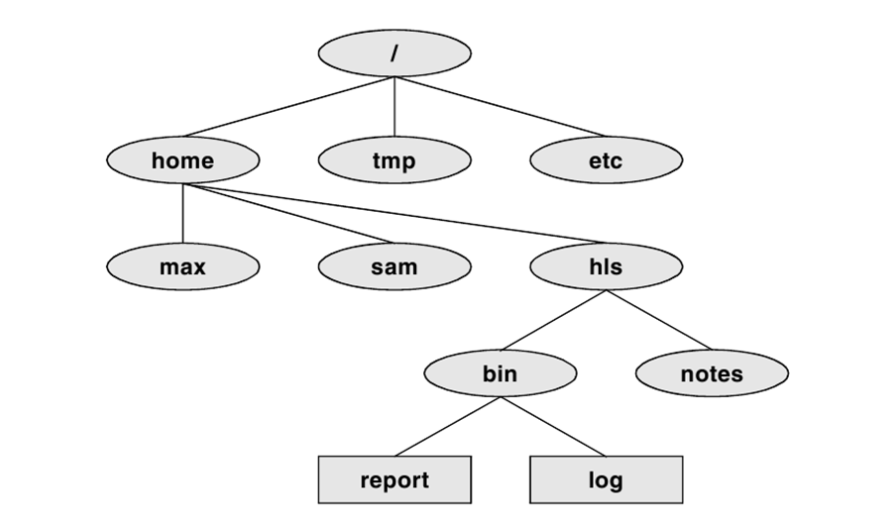
Linux File Structure
Notes:
UNIX uses a broader interpretation of files than found in most operating systems. In UNIX, a file is any source from which data can be read or any destination to which data can be written. Therefore, the keyboard, a source of input, is a file; the monitor, a destination for output, is a file; a printer, another destination for output, is a file; and a document stored on a disk, a source or destination of data, is also a file.
1. / – Root
Every single file and directory starts from the root directory.
Only root user has write privilege under this directory.
Please note that /root is root user’s home directory, which is not same as /.
2. /home – User home directory
A home directory is a file system directory on a multi-user operating system containing files for a given user of the system. The specifics of the home directory (such as its name and location) is defined by the operating system involved
As an ordinary user, you will create most of your files in your home directory, which is normally a subdirectory of /home. You might also access removable media mounted at /media, and perhaps network resources that might be mounted elsewhere. You can use /tmp and certain subdirectories of /var, too, although most users don't need to be explicitly aware of these locations—programs are normally hard-coded to use them for temporary files or for specific types of files, such as incoming e-mail files.
3. /bin – User Binaries
Contains binary executables.
Common linux commands you need to use in single-user modes are located under this directory.
Commands used by all the users of the system are located here.
For example: ps, ls, ping, grep, cp.

Slide 6
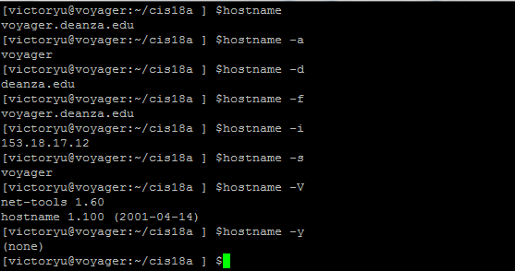
hostname: Displays the System Name
Notes:
hostname [option] [nameofhost]
Set or print name of current host system. A privileged user can set the hostname with the nameofhost argument.
-a, --alias
Display the alias name of the host (if used)
-d, --domain
Print DNS domain name
-f, -fqdn, --long
Print fully qualified domain name
-F file, --file file
Consult file for hostname
-h, --help
Print a help message and then exit
-i, --ip-address
Display the IP address(es) of the host
-s, --short
Trim domain information from the printed name
-V, --version
Print version information and then exit

Slide 7
File Name
A file name can be any sequence of ASCII characters
Some characters, although allowed, should not be used, e.g., >
Make file name as meaningful as possible
Never start a file name with a period (.) unless it’s a hidden file

Slide 8
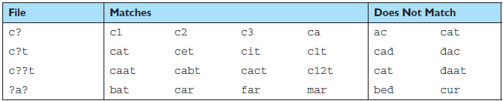
Matching Any Single Character
Notes:
Often it is necessary to group a set of files that all have the same filename except for one or two characters. For example, three files named
red1, red2, and red3 could be grouped by their first three characters. To do this, we would use a wildcard specification of red?
to group them.
The single-character wildcard can be used more than once in a group. You need to understand, however, that each ? can match only one character. The above table contains several examples of single-character wildcards.

Slide 9
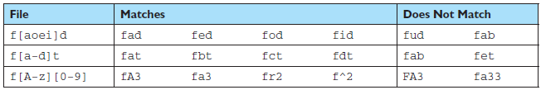
Matching A Single Character From a Set
Notes:
Sometimes, however, it is too powerful and we need to narrow the grouping. In this case, we use the character set, which specifies the characters that we want to match enclosed in brackets. Like the single-character wildcard, a set matches only one character in the filename. We can, however, combine the set with fixed values, other sets, the single-character wildcard, and the asterisk. Examples of the wildcard set are in the above table.
A word of caution about the third example in Table 3.2. The intent is that the second character in the filename can be any upper- or lowercase alphabetic character. However, if you examine the ASCII table in Appendix A carefully, you will see that there are six special characters between Z and a. If any of these special characters are found as the second character, and the rest of the specification is met, then the filename will be included in the group. Thus, we see that f^2 matches the wildcard specification. To limit the test to only alphabetic characters, we should use [A-Za-z].
Sometimes, it is easier to specify what we don’t want. For instance, if we know that the filename contains only lowercase alphabetic characters, we can specify the vowels with only 5 characters, and it takes 21 characters to specify the consonants. In this case, we can negate the set with the bang (!) character as shown here: f[!aeiou]*
This wildcard specification matches any file whose name begins with f and that has a consonant as the second character. Thus, fc and fd match, but f and fa do not.

Slide 10
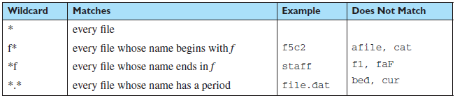
Matching Zero or More Characters
Notes:
The asterisk (*) is used to match zero or more characters in a filename. Whereas the single-character wildcard matched one and only one character, the asterisk matches everything, and everything includes nothing. Obviously, it is very powerful and you must be very careful when you use it.

Slide 11
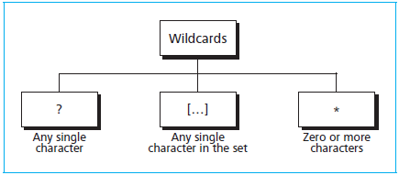
Wildcards
Tokens that represent one or more characters in a search
There are three types of wildcards

Slide 12
Explore the System
ls: lists directories and files
cd: changes directory
telnet: login in to a remote system
ssh: connects to another system securely
pwd: which directory am I in?
Notes:
1. $ head status_report $ tail status_report
2. The first command causes echo to display the characters c, a, and t on the screen. The second command uses cat to copy the contents of a file named echo to the screen. If there is no file named echo, cat displays an error message.
1. Which commands can you use to determine who is logged in on a specific
terminal?
who, finger, w
2. What happens when you give the following commands if the file named done already exists?
$ cp to_do done
$ mv to_do done
Both commands overwrite done with the contents of to_do.
3. How can you find out which utilities are available on your system for editing files? Which utilities are available for editing on your system?
Give the command apropos editor. Typical editors are vim, ex, ed, and gedit.
ls: by default, ls lists files alphabetically.
For finding old files, use the –t option. This sorts files by their modification time, or the last time the file was changed. The newest files are listed first.
-u option shows the files’ last-access time instead of the last-modification time.

Slide 13
Find Out Who Is Online
who: shows who's logged in
finger: looks up user information
w: shows who's logged in and what they are doing
Notes:
finger searches the .plan file and .project file.

Slide 14
Display File Contents
cat
echo $echo 'My Text' > myfile $echo f?t f-t flt fat fbt fgt fwt
Notes:
You can copy what you do with script. The bad part is that errors you correct and other terminal-control sequence will be in the file, too. If you edit or print the script file, it may be full of “junk” like ^M (carriage return) and ^H (backspace) characters. A command like cat –v or od -c will show those characters. You can clean it up by hand with your text editor’s global substitution commands.
cat (derived from catenate): $echo 'this is the contents of file1' > file1 $echo 'this is the contents of file2' > file2 $echo 'this is the contents of file3' > file3 $cat file1 file2 file3 this is the contents of file1 this is the contents of file2 this is the contents of file3
One way to check the existence of files using the wildcards is the use of echo command. As we learned before (see “Print Message (echo) Command” in prevous lesson), the echo command displays its argument. However, if the argument has a wildcard in it, the shell first expands the argument using the wildcard and then it displays it. It can be used with all wildcards. You can display all three-character filenames that start with f and end with t with the command.

Slide 15
Display Partial File Contents
more or less: display one page at a time
head: display the beginning of a file
tail: display the end of a file
Notes:
less is a full-screen application that gives you a searchable, scrollable window and clears the screen after you exit, less can also be backgrounded and restored like other full screen terminal applications. less also has a command to open the currently viewed file in your default editor. more just prints the text as is, stopping for page breaks, and does not clear the screen, it can be backgrounded but it doesn't clear the screen. more also only reads in the file as it displays where less may read the file into memory first. each handles line wrapping differently which gives different results when selecting and pasting text. both tools fulfill the same function but they do it in different ways, so you can pick whichever one you want for the situation at hand.

Slide 16
grep: Find Text
Find a string in a specific file, and print all the lines that contain the text $grep eggs basket
Display the line that contains the text and the surrounding lines $grep -5 eggs basket
Find out how many times a string appears: $grep –c eggs basket
Notes:
You can search through multiple files for specific strings of characters and then view the list of matching files onscreen.

Slide 17
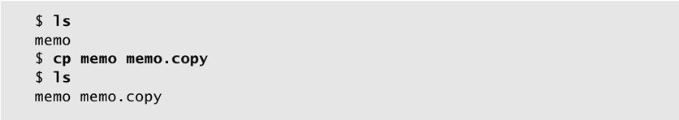
cp: Copy a File
Notes:
Copy a file or directory from source to destination
To copy a file, you need to pass source and destination to the copy command. The following example copies the file from project/readme.txt to projectbackup/readme-new.txt
$ cp project/readme.txt projectbackup/readme-new.txt
$ cd projectbackup/
$ ls readme-new.txt
If you want to copy a file from one folder to another with the same name, just the destination directory name is good enough as shown below.
$ cp project/readme.txt projectbackup/
$ cd projectbackup/
$ ls readme.txt
A directory (and all its content) can be copied from source to destination with the recursive option -r as shown below:
$ ls project
src/ bin/ doc/ lib/ test/ readme.txt LICENSE
$ cp -r project/ backup/
$ ls backup src/ bin/ doc/ lib/ test/ readme.txt LICENSE
2. Copy multiple files or directories
You can copy more than one file from source to destination as shown below:
$ cd src/
$ cp global.c main.c parse.c /home/thegeekstuff/projectbackup/src/
If the source files has a common pattern, use wild-cards as shown below. In this example, all c extension files gets copied to /home/thegeekstuff/projectbackup/src/ directory.
$ cp *.c /home/thegeekstuff/projectbackup/src/
Copy multiple directories as shown below.
$ cd project/ $ cp -r src/ bin/ /home/thegeekstuff/projectbackup/
3. Backup before copying into a destination
In case if the destination file is already present with the same name, then cp allows you to backup the destination file before overwriting it.
In this example, the readme.txt exists in both project/ and projectbackup/ directory, and while copying it from project/ to projectbackup/, the existing readme.txt is backed up as shown below:
$ cd projectbackup
$ ls -l readme.txt -rw-r--r-- 1 bala geek 1038 Jan 8 13:15 readme.txt
$ cd ../project
$ ls -l readme.txt -rw-r--r-- 1 bala geek 1020 Jan 8 12:25 readme.txt
$ cp --backup readme.txt /home/thegeekstuff/projectbackup/
The existing file has been moved to readme.txt~ and the new file copied as readme.txt as shown below.
$ cd /home/thegeekstuff/projectbackup/
$ ls -l
-rw-r--r-- 1 bala geek 1020 Jan 8 13:36 readme.txt
-rw-r--r-- 1 bala geek 1038 Jan 8 13:15 readme.txt~
Talking about backup, it is important for you to understand how rsync command works to backup files effectively.
5. Don’t overwrite an existing file
If you want to copy only when the destination file doesn’t exist, use option -n as shown below. This won’t overwrite the existing file, and cp command will return with success exit code as shown below:
$ cd projectbackup
$ ls -l readme.txt
-rw-r--r-- 1 bala geek 1038 Jan 8 13:15 readme.txt
$ cd ../project
$ ls -l readme.txt -rw-r--r-- 1 bala geek 1020 Jan 8 12:25 readme.txt
$ cp -n readme.txt /home/thegeekstuff/projectbackup/bin/
$ echo $?
0

Slide 18
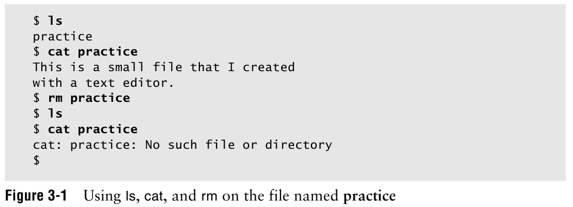
rm and Its Danger
Notes:
Deletion with confirmation: rm –i

Slide 19

mv: Rename a File
mv: rename a file without making a copy
Caution: mv can destroy a file:
Use the –i option as a safe guard

Slide 20
date: Displays the Time and Date
date displays the current date and time
You can specify the format $date +"%A, %B %d, %Y“ $Tuesday, January 21, 2014
Notes:
The date command displays the system date and the time. If the system is local—that
is, one in your own area—it is the current time. If the system is remote, such as across
the country somewhere, the reply will contain the time where the system is physically
located.
The input for date is the system itself; the date is actually maintained in the computer
as a part of the operating system. Most modern hardware also has a hardware
General Command Format
verb option(s) argument1 argument2 … argumentn
The name of the command Command Modifier Usually one character preceded by ± Arguments can be:
1. More information
2. Object identifiers
3. Names of files
The date Command
date options argument
-u: Universal
date
System
Display time and date for this time yesterday: date –d”yesterday”
Using Xming, display xclock

Slide 21
cal: Displays Calendar
cal displays the calendar of a month or year
If no arguments are provided, it prints the current year
If both a month and a year are provided, it prints one month $cal -1
January 2014
Su Mo Tu We Th Fr Sa
1 2 3 4
5 6 7 8 9 10 11
12 13 14 15 16 17 18
19 20 21 22 23 24 25
26 27 28 29 30 31
Notes:
xclock &

Slide 22
sort It Out
sort sorts the line according to ASCII order
-d option: in dictionary order
-f option: ignore case
-r option: in reverse order
-t option: change the default delimiter
-k n[,m]: starts at the nth field, where the fields are numbered beginning with 1, and ends at the mth field
Notes:
sort sorts the list according to the order established in the ASCII (American Standard Code for Information Interchange ) character definition. This says that numbers come before uppercase letters, which come before lowercase letters.
If you want the order of the file to be what you expected, you must use the –d option, which lists according to the rules used in the dictionary. That means that only letters, digits, and tabs are significant for the ordering.
But the files are still ordered with the uppercase letters appearing first in the list. The –f option instructed sort to treat all letters as equals.
Use –t to change the default field delimiter
If you have multiple files to sort, you can use: sort file1 file2 file3 > complete.sorted.file and the output will contain the contents of all three fields—sorted, of course
You can sort fields on comma-delmited files by adding –t to the command. For example, sort –t, +1 address.book tells Linux to sort by the second field. The –t and following character (,) indicate what character separates the fields—the comma in this case. If a character isn‘t given, sort thinks that white space marks the boundaries between fields. The +1 says to skip the first field and sort on the second one.

Slide 23
uniq: Eliminate Duplicates
uniq finds only identical, adjacent (sorted) lines.
use -d option to display only the duplicate lines
You can sort and eliminate duplicates in one step with: sort –u long.address.book

Slide 24
write: Communicate with Others
write sends a quick message to others who logged in to the same system.
write userid
Wanna meet for lunch?
Ctrl+D
The message will suddenly appear on the recipient's screen and can be intrusive
Keep other people from sending you message mesg n

Slide 25
Special Characters
Characters with special meaning to the shell
Whitespaces: RETURN, SPACE, TAB
Quotes:
'text' - protects the contents
"text" - expands the contents
`text` - executes as a command
Notes:
Quotes
Example:
$ VAR=ls
$ echo '$VAR‘
$ $VAR
$ echo "$VAR“
$ ls
$ echo `$VAR`
$ Mail cis18a cis18b cis35a cis71A data data2 dead.letter fonts.scale mail mbox perl practice
Wildcard (*): matches 0 or more characters in a file name
Questions mark (?): matches any single character

Slide 26
Special Characters
* substitutes for zero or more characters
? substitutes for any single character
[charset] substitutes for any single character in the set charset
Notes:
Use a wildcard to substitute for a weir character in a file name: mv file?name file_name
Delete files with odd names:
Delete files whose names that start with a dash: rm ./-f
Delete files with strange names, using wildcards: $ls What now a$file prog|.c program.c $rm –i a* rm: remove a$file? Y $mv prog?.c prog.c

Slide 27
Locate a Utility
which
whereis
Notes:
which [options] [--] [commands] list the full pathnames of the files that would be executed if the named commands had been run.
whereis [options] files locate the binary, source, and manual page files for specified commands/files.

Slide 28
Running Commands in Background
$xclock & [1] 11446 $jobs [1]+ Running xclock & $fg 1 xclock ctrl-c $
Notes:
To see the jobs running in the background jobs [1] is job id
To bring process running in the background to the foreground $JOB-ID or fg JOB-ID
To kill the jobs in the background, (PID = process id) kill PID killall

Slide 29
Pipe and Redirect Output
Pipe (|): connect the output of one program to the input of another program
Redirect (>): redirect the output to a file
Redirect and append (>>): redirect the output and append to a file
Notes:
In general, you can think of each Unix command (ls, cd, and so on) as an individual program that Unix executes.
Frequently, you will want to run programs in sequence. For example, you could tell Unix to read your resume and spell-check it. In doing this, you connect two commands together and have them run in sequence. This process, in which you connect the output of one program to the input of another, is called piping. Depending on what you want to do, you can pipe together as many commands as you want—with the output of each command acting as the input the next. ls | more

Slide 30
Questions (1)
Which commands can you use to determine who is logged in on a specific terminal?
What happens when you give the following commands if the file named done already exists? $cp to_do done $mv to_do done
How can you find out which utilities are available on your system for editing files? Which utilities are available for editing on your system?
Notes:
1. Which commands can you use to determine who is logged in on a specific
terminal?
who, finger, w
2. What happens when you give the following commands if the file named done already exists?
$ cp to_do done
$ mv to_do done
Both commands overwrite done with the contents of to_do.
3. How can you find out which utilities are available on your system for editing files? Which utilities are available for editing on your system?
Give the command apropos editor. Typical editors are vim, ex, ed, and gedit.

Slide 31
Questions (2)
Which commands can you use to look at the first few lines and the end of a file named status_report?
Try giving these two commands: $echo cat $cat echo Explain the differences between the output of each command
Notes:
1. $ head status_report $ tail status_report
2. The first command causes echo to display the characters c, a, and t on the screen. The second command uses cat to copy the contents of a file named echo to the screen. If there is no file named echo, cat displays an error message.

